Slide 1
Bathrooms Classifier
Aldo N. Cao Romero
June 2021

Slide 2
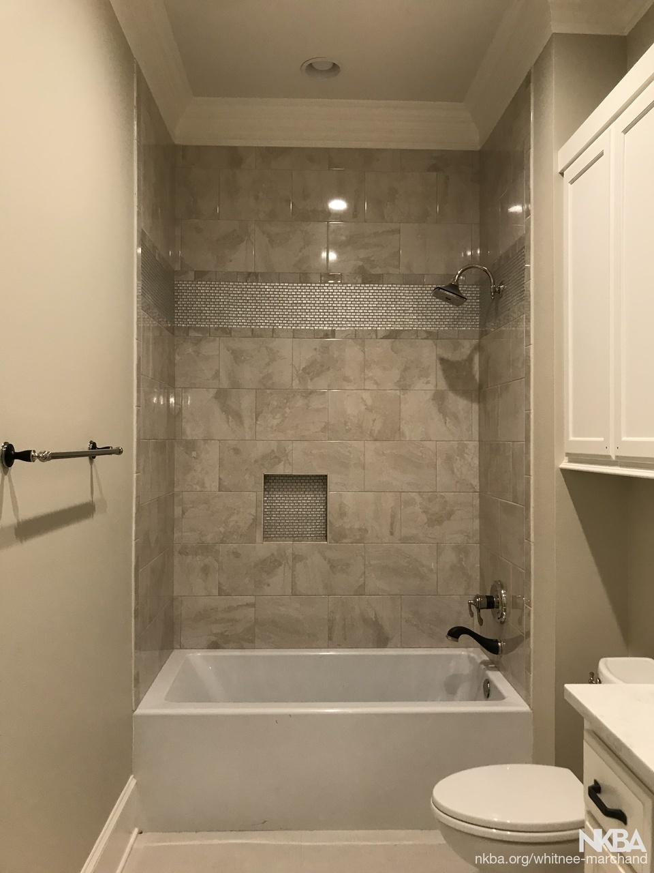
Use case
The creation of a model that classifies the houses by the number of bathrooms and, in this way, predict which houses can qualify for adding a new bathroom

Slide 3
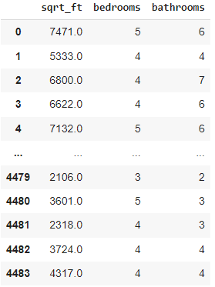
We take the cleansed data of the raw house data, and took the variables we will use for the model

Slide 4

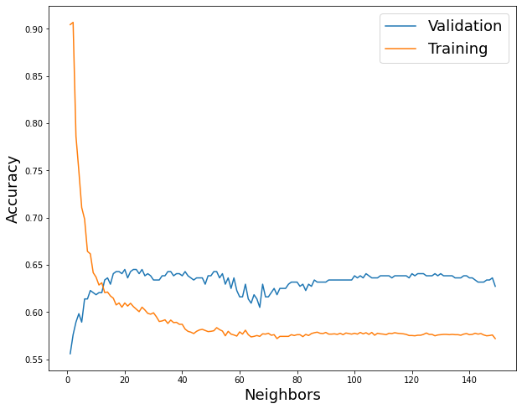
The model was trained using the KNN classifier along with the normalization:

Slide 5
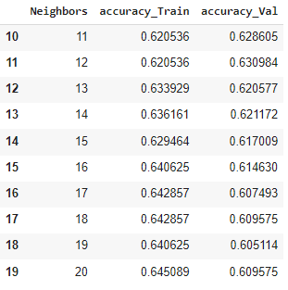
The amount of neighbors that gives us the best accuracy for the model was 14, which corresponds to an accuracy of 62%

Slide 6
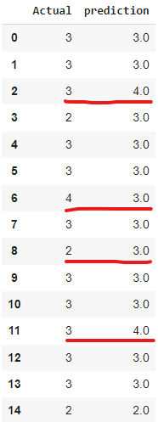
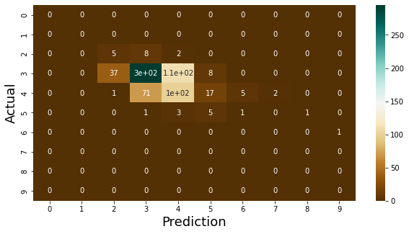
Then, we test our model with the test data and obtain an accuracy of 60% and we get the following behavior:

Slide 7
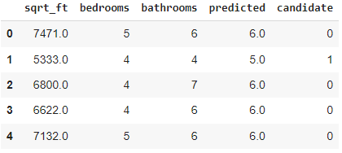
It was taken the values that the model predicts larger than the actual value and we assume the house might have the possibility of adding a new bathroom. It was obtained a total of 734 candidates of adding a new bathroom

Slide 8
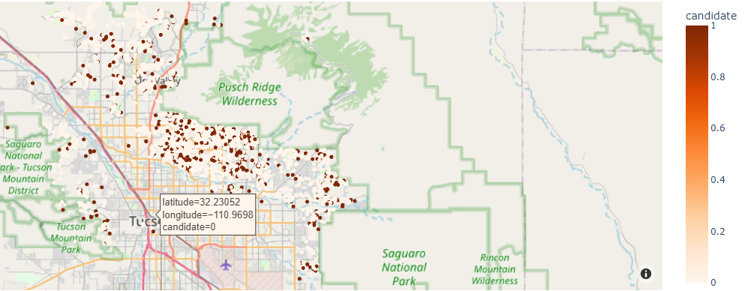
We locate in the map the houses that are possibly able to have a new bathroom

Slide 9
Conclusions
We create a model that classifies the houses with a certain amount of bathrooms and find the optimal quantity of K-Neighbors
By getting the confusion matrix, we were able to observe that the predictions differs only by one in many cases.
We propose that, in the houses where the predicted value was larger than the actual value, those houses can be candidates of adding a new bathroom.
We locate in the the map the houses that we can offer the possibility of adding a bathroom

Slide 10
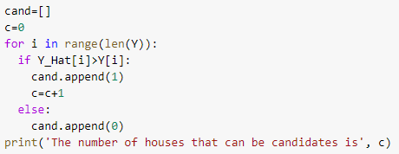
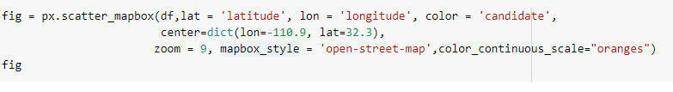
Appendix

